Slide 1

Introduction to PLOTINA Online module: looking at sex/gender from multi-disciplinary lenses
Charikleia Tzanakou,
University of Warwick – PLOTINA team
Notes:
Hello my name is Charikleia Tzanakou, I am working at the University of Warwick and I am part of the PLOTINA project.
In this brief podcast I will do a brief introduction to the
PLOTINA online Module: looking at sex/gender from multi-disciplinary lenses

Slide 2
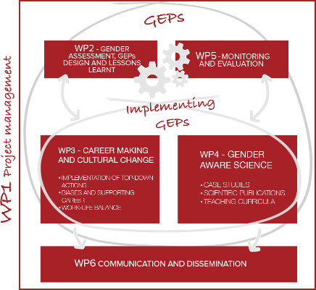
What is PLOTINA?
Horizon 2020 European project (4y duration)
“Promoting gender balance and inclusion in research, innovation and training’
Self-assessment, design, implementation and evaluation of gender actions
10 partners, 6 RPOs: diversity
Notes:
What is PLOTINA : PLOTINA is an EU funded project under the H2020 programme which stands for Promoting gender balance and inclusion in research, innovation and training. The overall objective of PLOTINA is to enable the development, implementation and assessment of self-tailored GEPs, with innovative and sustainable strategies for Research Performing Organizations. As part of this, the PLOTINA Consortium has been working intensely for four years, and the result is a set of modular and adaptable resources for any RPO to use.
The PLOTINA project is implemented by the PLOTINA Consortium which is comprised of 10 partners across Europe. Among these, there are 6 research performing organisations including
University of Bologna, Italy (UNIBO)
University of Warwick, United Kingdom
National Institute of Chemistry, Slovenia (NIC)
Mondragon University, Spain (MU)
Lisbon School of Economics and Management, Portugal (ISEG)
Ozyegin University, Turkey (OZU)

Slide 3
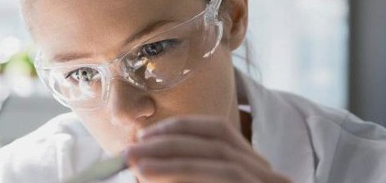
Three overall objectives
Removing barriers to recruitment, retention and career progression
Improving decision making by addressing gender imbalances
Integrating the sex/gender dimension in research/teaching
Notes:
PLOTINA aims to contribute towards three overall objectives:: removing barriers to recruitment, retention and career progression of female researchers; reducing gender imbalances in decision making bodies;

Slide 4
PLOTINA Module
Targeting postgraduate students and early career researchers – but also beyond
Raise awareness about sex/gender issues
Complex, multidimensional
Contributions from colleagues across different difficulties
9 podcasts
Notes:
One of the PLOTINA deliverables was for the PLOTINA team at the University of Warwick to develop a module addressed to postgraduate students and early career researchers (and potentially of value to undergraduate, academics and or wider public) that would raise awareness about sex and/or gender issues in different disciplines. Gender issues are complex and multidimensional and it is often challenging to find colleagues who perceive these issues similarly even within the same discipline. When one embarks in getting contributions from colleagues especially across different disciplines, it becomes increasingly tricky to share similar understanding and perceptions on this topic which is reflected in the collection of podcasts in this module.
You will find 9 podcasts in this module that will enable you to look at sex/gender issues from different disciplinary perspectives provided by experts in sociology, biomedicine, physics, statistics, behavioural science, history. The contributors are coming from a diverse range of career stages, institutions and geographical contexts although there are quite a few from the University of Warwick for obvious reasons.

Slide 5
Podcasts : a rich tapestry
Gender and Science: scientific facts and fictions of gender
Gender and the history of science
Physics and gender
Gender and academic research: a linguistic perspective
Neuroscience and Gender: Seven things to know about sex, gender, brains and behaviour
Biomedical sciences and gender
Economics and gender: Publishing while female, are women held to higher standards: evidence from peer review
Statistics and gender: focus on indicators and gender equality
Gender inclusive teaching
Notes:
So the 9 podcasts and contributors are the following ( I apologise in advance for nay mispronounciation):
Gender and Science: scientific facts and fictions of gender by Dr. Liz Ablett
Neuroscience and Gender: Seven things to know about sex, gender, brains and behaviour by Professor Cordelia Fine
Biomedical sciences and gender by Dr. Antonia Sagona
Statistics and gender: focus on indicators and gender equality by Dr Anne Laure Humbert
Physics and gender by Professor Helen Goethchel
Gender and the history of science by dr. Michael Bycroft
Gender and academic research: a linguistic perspective by Anastasia Stavridou
Economics and Gender: Publishing while female, are women held to higher standards: evidence from peer review from dr. Erin Hengel
Gender inclusive teaching from Hannah Ayres.

Slide 6
PLOTINA module – overlapping themes
Critique of scientific knowledge as objective
Gendered world of science
Biases can be found
Exclusion of women in science
Role models
Notes:
What is interesting about this collection of contributions is not the differences in looking at sex/gender issues but how disciplinary lenses overlap and highlight particular aspects that we should be aware of and consider in our research practice.
These overlapping themes have been the following:
The critique of scientific knowledge as objective and authoritative and the importance of understanding that it is situated in specific contexts (influenced by actors, times and places) which is raised by Dr Ablett, Dr Sagona and Dr Bycroft
Linked to the previous point, the gendered world of science which is shown through examples of gendered scientific practices and knowledge, reflecting gendered assumptions and prejudices in podcasts by Dr Ablett and Dr Bycroft and Dr Goetchel and Professor Fine. Biases in publications which exaggerate sex/gender differences are explicitly reported in Professor Fine and Dr Ablett’s podcasts
The exclusion of women in science is mentioned in most podcasts while the contributors provide us with names and biographies of women role models in different disciplines (Dr Bycroft, Dr Ablett, Dr Goetchel, Dr Sagona)
You will also find one podcast devoted to queer pedagogy and why it is important to consider gender in the classroom.

Slide 7
How it should be used
As online module
Part of a lecture/seminar
Part of Reading list
Credits could be applied
Assessment
Notes:
The podcasts could be used together as an online module within degree programmes to provide different disciplinary lenses and food for thought to students. However, each one of them could be utilised as part of a lecture or a seminar or ‘a reading list’ within different disciplinary programmes and modules. In many institutions, there are interdisciplinary modules that can be available to students from different degree programmes.
If local/institutional rules require credit points for a module, then the above programme could be supplemented a method of assessment which should be defined by the module leader in each institution. For example an individual essay or project work could be potential options.

Slide 8

Collective ‘illuminating’ undertaking
Thank you to all the contributors
This Photo by Unknown Author is licensed under CC BY-SA
Notes:
This has been a collective illuminating undertaking that would not have been possible without the contributors. We would thus like to thank all the contributors for the energy, time and effort they put into these podcasts and we do hope that that this module would be useful to individuals, teachers, researchers and research performing organisations.

Slide 9
THANK YOU!
More info on PLOTINA:
http://www.plotina.eu
Email: Charikleia.Tzanakou@warwick.ac.uk
Twitter:@ctzanakou
Tweet if you have found this useful ☺
Notes:
Thank you for your attention. You can find more information about PLOTINA on our dedicated website If you have any questions or comments please contact us at the email address provided here. And if you do find the module useful drop us an email and/or tweet about it ☺

