Slide 1
The following podcast (Title: Gender and Science: Scientific Facts and Fictions of Gender) has been developed as part of the PLOTINA project
Project H2020 (2015-2020) GA n° 666008 Coordinated by
Alma Mater Studiorum – Università di Bologna
Prof. Tullia Gallina Toschi
Notes:
XXX = Name of the presenters
XXXX = Institution name of the WP Leaders
1

Slide 2

Gender and science:
Scientific Facts and
Fictions of Gender

Slide 3
Structure of the Lecture
Scientific Facts and Fictions of Gender:
Scientific Discourse and Metaphors
The Scientific Research Process
Social and Political Effects of Scientific Research
The Institutions and Protagonists of Science

Slide 4
Scientific Discourse and Metaphors

Slide 5
The Power of Scientific Metaphors
‘Metaphors and analogies direct the investigators’ attention to some aspects of reality and not others. (…) [They] can generate a considerable amount of new information about the world that confirms metaphoric expectations and direct attention away from those aspects of reality that challenge those expectations. (…)
(Stepan,1986: 274)

Slide 6
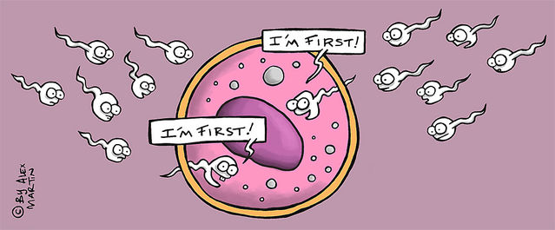
Egg and Sperm: A Scientific Fairy Tale?
‘Gender stereotypes [are] hidden within
the scientific language of biology.’ We
learn ‘about more than just the natural
world in high school biology class; we
(…) lear[n] about cultural beliefs and
practices as if they were part of nature’.
(Martin, 1991: 485 – 486)
‘[B]ecoming aware of when we are projecting cultural imagery onto what we study will improve our ability to investigate and understand nature. Waking up such [gendered] metaphors, by becoming aware of their implications, will rob them of their power to naturalize our social conventions about gender.’ (Martin, 1991: 501)
→ There are many examples of gendered assumptions in science: e.g. ‘male hunter’/‘female gatherer’; X chromosome (Richardson, 2012)

Slide 7
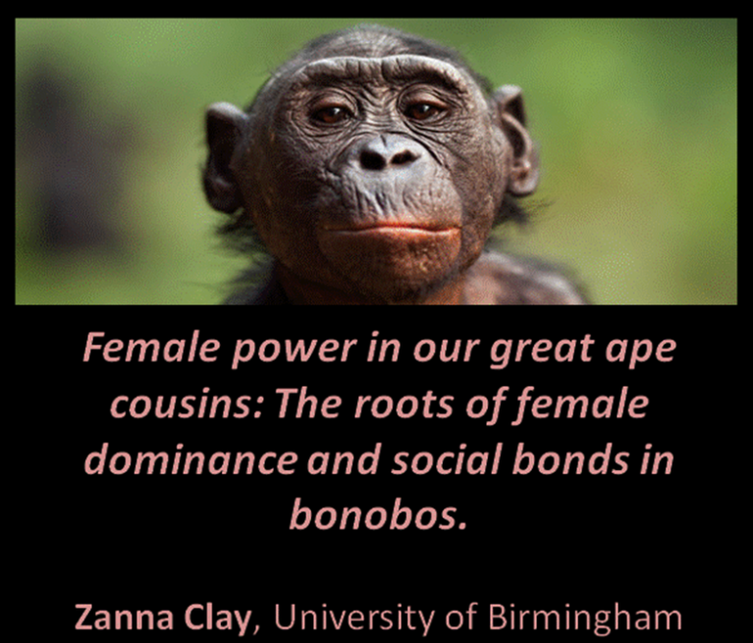
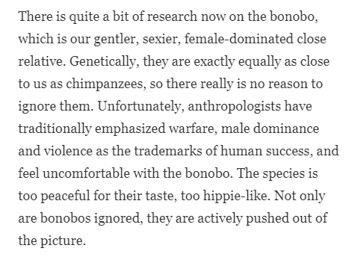
Gendering Animals
Assumptions about ‘feminine’ passivity
and ‘masculine’ aggressiveness and competitiveness have also shaped analyses of the animal world:
influence what scientists look for
make aspects of animal life go unnoticed (e.g. female-female competition, female aggression and sexual initiative)
affect interpretations of animal behaviour (Haraway, 1989; Schiebinger, 1994, 2001; Zuk, 1993)
These skewed interpretations were/are often framed in popular culture as insights into the true ‘nature’ of males and females, and used to justify essentialist claims about the traits of men and women.
Frans de Waal, biologist & primatologist, Professor at Emory University
https://www.forbes.com/sites/quora/2016/09/21/bonobos-are-peaceful-female-dominated-and-closely-related-to-humans-why-do-we-ignore-the-link/#204543b213ae

Slide 8
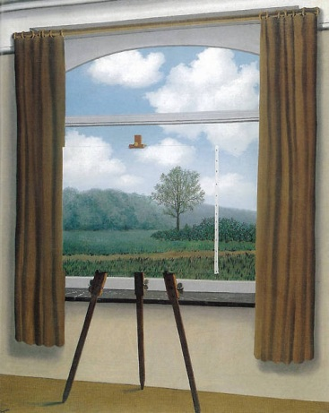
Science as a Window into the World
In contemporary Western societies, scientific research is often understood to be the most reliable, authoritative and objective method for producing knowledge about the world. There is a widely shared view that through the accumulation of small and major scientific breakthroughs we can gradually get closer to discovering the truth about
what things really are like and how
they operate.
In ‘late-twentieth-century affluent societies
(…) [there is a] presumption of credibility
that immediately accrues to any findings
reported with the assurance that they are
based on scientific research’, especially when
produced by the ‘exact sciences’, which are
‘grant[ed] pride of place’ in the scientific
hierarchy.
(Lorraine Code, 1995: xii)

Slide 9
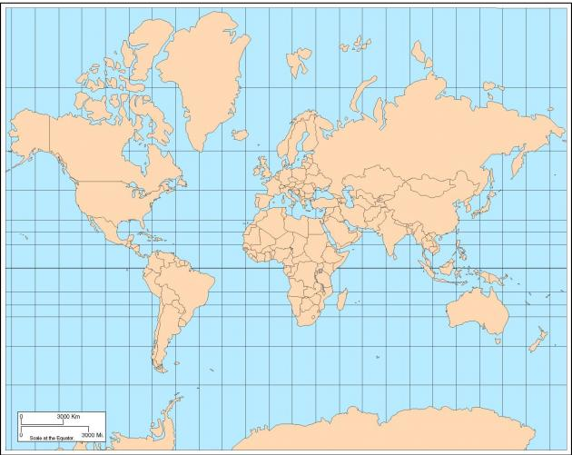
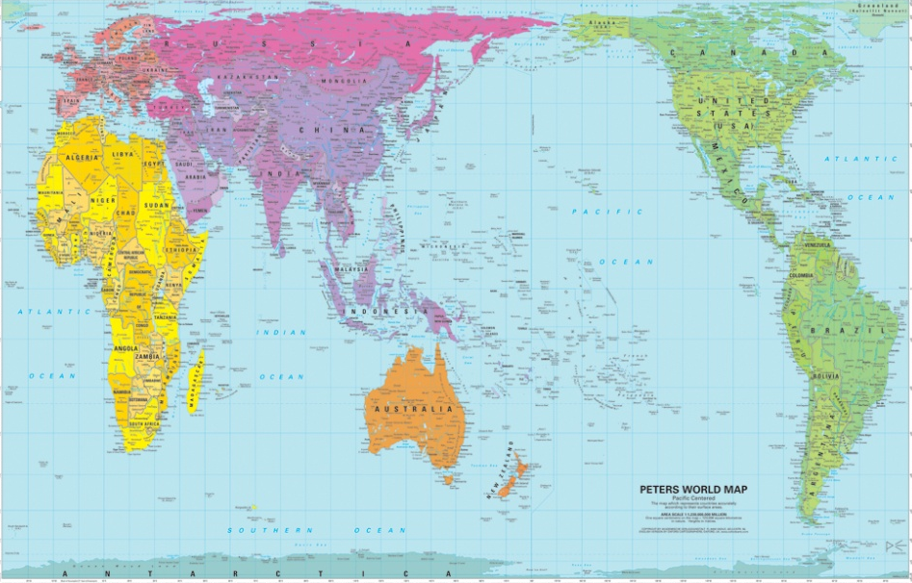
Science as a Political System
Because of its considerable authority, scientific knowledge plays a key role in shaping broader social relations of power and inequality.
‘whoever gets to define what counts as (…) scientific (…) also gets a powerful role in shaping the picture of the world that results from scientific research’
(Sandra Harding,
1991: 40)

Slide 10
Science as a Cultural System
However, philosophers, sociologists and other scholars (including gender theorists such as Donna Haraway and Sandra Harding) have argued that science does not, and cannot, actually provide us with objective and transparent access to the reality of the material world.
Science is a cultural system (Franklin, 1995), shaped by social norms, ideals and ideologies, and historically specific priorities and preoccupations. It is inextricable from the social, political and economic context in which it is produced, and to some extent reflects the particular worldviews, values and attitudes of those who carry it out and control it, including their representations of gender (and ‘race’, sexuality, etc.).
→ See for example: Laqueur’s (1990) discussion of the scientific transition from a one-sex to a two-sex model and the role of science
in forcing intersex bodies to conform to social norms

Slide 11
The Scientific Research Process

Slide 12
Biases in the Research Process
Cultural norms shape the practices of scientific research on many levels:
topics studied: e.g. historically, much more research on female, than male, contraceptives (in line with notion that reproduction is a female responsibility) (Hanmer, 1997) → the sexist (and racist) history of contraception (for examples, see this article and https://www.facebook.com/
fusionmedianetwork/videos/1626256187400353/ )
questions asked: e.g. sociological studies which ask people if they believe there exist differences between women and men, but do not ask about similarities; mainstream psychological research which explicitly focuses on identifying differences between women and men - ‘sex-difference research’ (Eagly, 1995)
  according to Rodino, this is ‘the “question of questions”: why do we ask questions that strengthen the male – female dichotomy?’ (1997: 2)
  ‘when researchers (and others) think about sex and gender, what they
  “see” is difference. Within our usual mindset and our usual research de-
  sign, gender similarity is not a positive state; it is merely the absence of
  proven difference (literally, the null hypothesis)’ (Connell 2002: 42)

Slide 13
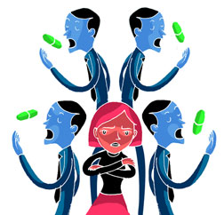
Biases in the Research Process
research design and study
participants: e.g. sociological
studies of class focusing only on
men (Abbott et al, 2005);
participants usually categorised
in binary ways; decades-long sex
bias in research: researchers
preferentially study diseases and
test drugs in males (Corrigan, 2002;
Herz, 1997; Kim et al, 2010; Rosser,
1989; Zucker and Beery, 2010)
  e.g. although more women than men die from heart disease each year, women comprise only 10 % - 47 % of the subject pool in 19 heart-related trials in the US (Kim et al, 2008).

Slide 14

Biases in the Research Process
findings highlighted and published: across fields, there exists a systematic and widespread publication bias. Researchers and editors tend to value results that are positive (i.e. showing a significant finding) more highly than results that are negative (i.e. supporting the null hypothesis) or inconclusive.
  as a result, positive statis-
  tically significant results are
  three times more likely to be
  published (Dickersin et al,
  1987)
  positive results are also
  much more likely to be co-
  vered by the media

Slide 15
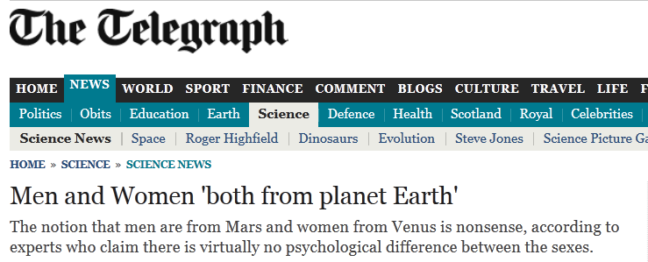
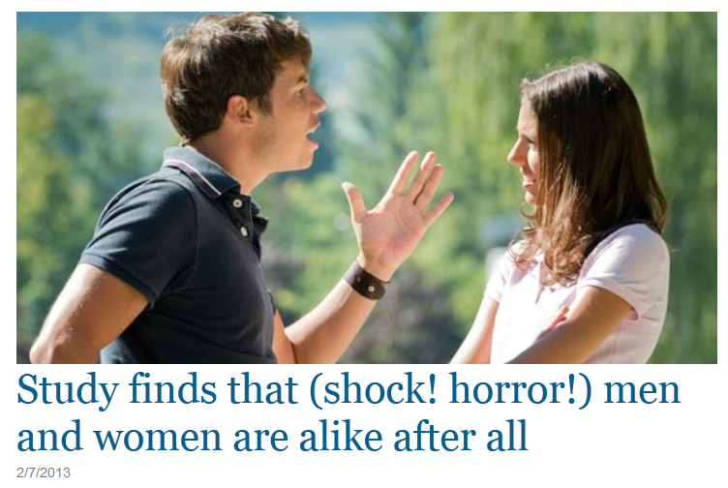
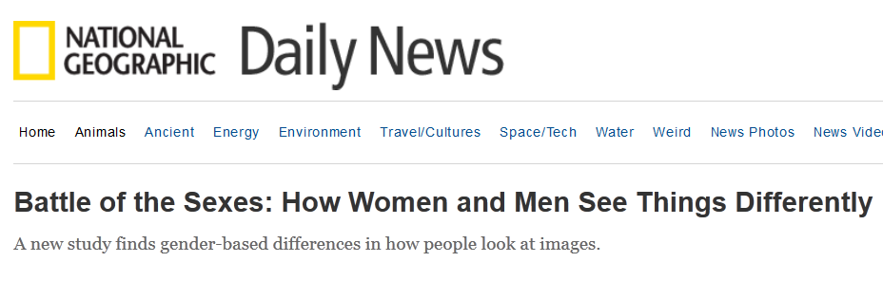

Slide 16
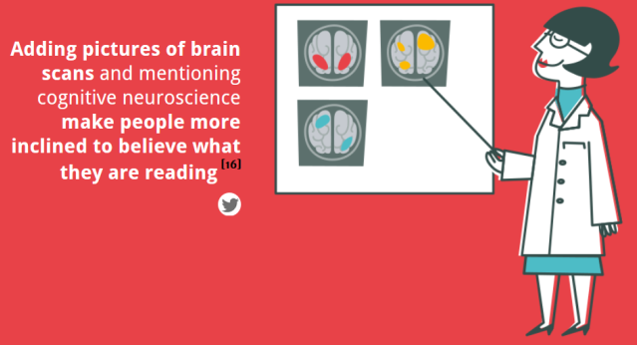
The Effects of Publication Bias on Hegemonic Discourses of Gender
positive results are much more likely to be covered by the media and become part of hegemonic discourses about gender.
This is very significant for the social construction of gender because there is evidence that media reports of gender that emphasise biological and neurological factors make us more inclined to:
agree with gender
stereotypes;
to self-stereotype
ourselves;
and to align our
performance with
those stereotypes
(Fine, 2010)
(see McCabe and Castel, 2008;
http://neomam.com/interactive/13reasons/)

Slide 17
Social and Political Effects of Scientific Research

Slide 18
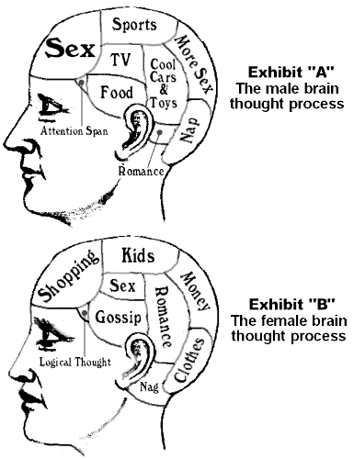
The Growth of Modern ‘Neurosexism’
Although they suffer from significant empirical, methodological and conceptual problems which raise doubts about their results,
scientific studies which claim to show that there
exist ‘hardwired’ neurological sex differences
receive considerable media coverage and exercise a
growing influence over policy and practice (parti-
cularly in education and business). (Fine 2010,
2012; Jordan-Young, 2010)
‘[Neurological explanations for inequality] permi[t]
us to sit back and relax, with [their] seemingly neat
explanation of our social structure and personal
lives. The answer, ‘Oh, it’s the brain,’ offers a tidy
justification for accepting the status quo with clear
conscience.’ (Fine, 2008)
(A similar phenomenon occurs in relation to ‘race’, for example in claims
about IQ – see Mirza, 1998)

Slide 19
Science and the (Re)Production of Social Inequalities
Historically, science played a key role in reifying, reproducing and legitimating social inequalities. (Fausto-Sterling, 1992; Fine, 2010; Jacobus et al, 1990; Martin, 1992; Stepan, 1986)
  Gender: e.g. in Victorian Britain, scientists researched women’s brains to demonstrate their inferiority; studies of the uterus and of women’s psychological states used to argue that they should not be educated, vote or lead active public lives.
  ‘Race’: e.g. studies of brains and bodies sought to demonstrate black people’s greater closeness to primates and hence less ‘evolved’ nature relative to white people → this made it possible to legitimate colonialism, slavery, racial segregation, etc.
  similar uses of science in relation to sexuality, class, etc.
In contemporary Western societies, this emphasis on the brain as
site and evidence of difference, and hence as a justification for inequa-
lity, is still present. (Fine, 2010; Jordan-Young, 2010; Mirza, 1998)

Slide 20
The Institutions and Protagonists of Science

Slide 21
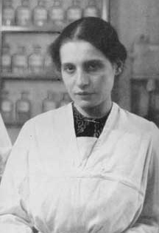
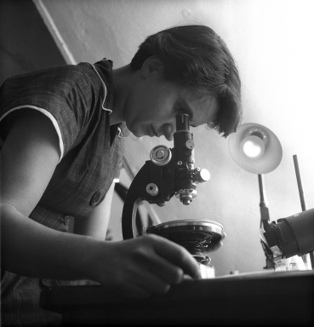
The Historical Erasure of Women Scientists
For many decades, women were actively excluded from scientific work and scientific societies.
  e.g. Lise Meitner (1878 – 1968), who played a leading role in the advancement of knowledge on radioactivity and nuclear fission, was not allowed to enter the laboratories where the male students worked; she was forced to work in a shed outside.
When they were able to overcome obstacles to make decisive contributions to award-winning scientific breakthroughs, their contributions were often not acknowledged or rewarded.
  e.g. Rosalind Franklin (1920 – 1958), who
  played a decisive role in the discovery of the
  ‘double helix’ in DNA

Slide 22

Gender Discrimination in Contemporary Science
Female and male scientists are portrayed differently in the media
  Men much more often cited as expert scientific sources than women: 5 men quoted for every 1 woman.
  Journalists more likely to comment on appearance
  when writing about women: 50% of the profiles of
  female scientists mentioned clothing, physique or
  hairstyle; 20% for male scientists.
  Many descriptions of women imply a contradiction
  between being a ‘real woman’ and a ‘real scientist’.
  Women in Science, Technology, Engineering and
  Mathematics (STEM) who are seen as conforming to
  traditional stereotypes such as ‘the geek’ are
  sometimes implicitly presented as unfeminine.
  Alternatively, if they are ‘sexy’ and ‘glamorous’ their
  status as scientists may be thrown into question.
  Interviews with scientists show the negative
  impact of these gendered representations and the
  limited range of publicly available images of women
  scientists.
  (Kitzinger et al, 2008)

Slide 23
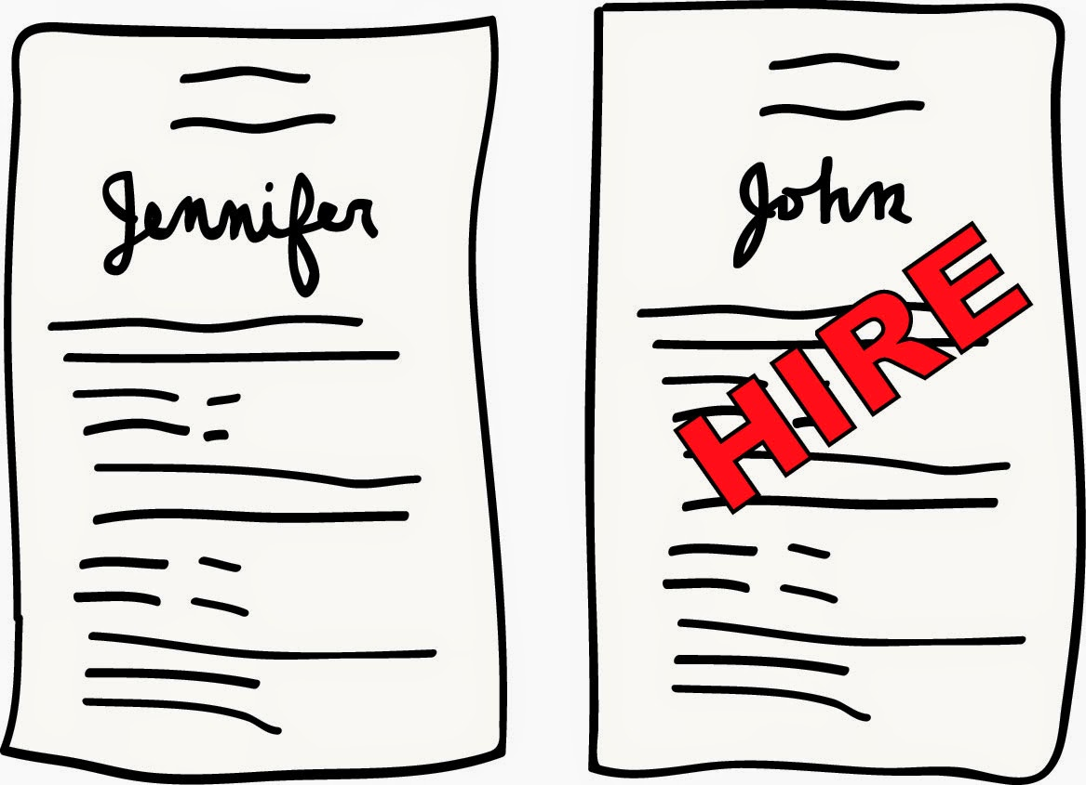
Gender Discrimination in Contemporary Science
As a result, female and male scientists are seen and treated differently:
  “Women scientists 'distract men, fall in love with them and cry when criticised,' says Nobel Prize winner Tim Hunt” (2015)
    For a response, see this TEDx Talk: https://www.youtube.com/watch?v=ZEgqJe2QxAo
  A very recent study by Moss-Racusin et al (2012) demonstrated that both male and female science faculty’s assessment of applicants is shaped by gender bias:
    Male candidate rated as more
    competent and hireable
    and offered a higher star-
    ting salary (14% higher) and
    more career mentoring
    Female candidate rated as
    more likeable

Slide 24
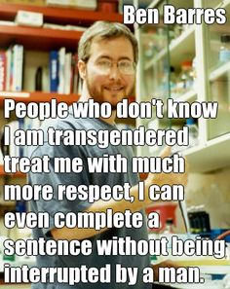
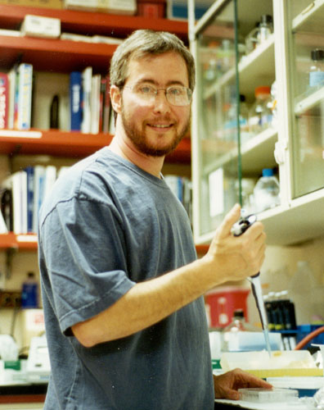
Gender Discrimination in Contemporary Science
Female and male scientists are treated diffe-
rently (continued)
  Clear evidence for the continued existence of gen-
  der bias in science is provided, for example, by the
  experience of neurobiologist Ben Barres (2006), a
  trans man.
  In an article published in Nature (written in res-
  ponse to Larry Summers’ (2005) polemic claim
  that women are naturally less talented for scien-
  ce than men), Barres reported being treated very
  differently before and after transitioning:
    as a woman: as the only person in an almost
    all-male class to solve a difficult problem, was told that ‘your boyfriend must have solved it for you’; lost a fellowship to male colleague despite being considered to have a much stronger application
    after transitioning: his work was described as ‘much better than his
    sister’s’; treated with much more respect; not interrupted by other men.

Slide 25
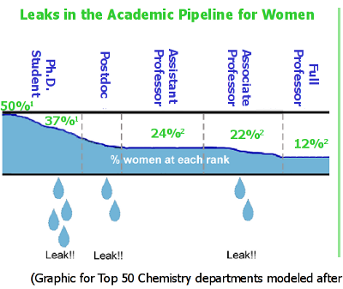
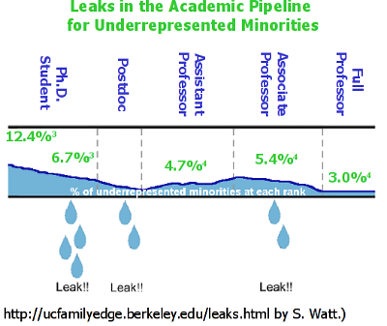
Gender Discrimination in Contemporary Science
All of the above contributes to produce what has been described as a ‘leaky pipeline’ effect

Slide 26
Changing Science

Slide 27
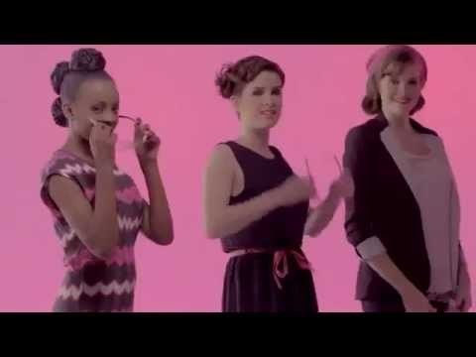
Campaigns to Encourage Women to Pursue STEM
https://www.youtube.com/watch?v=zj--FFzngUk

Slide 28
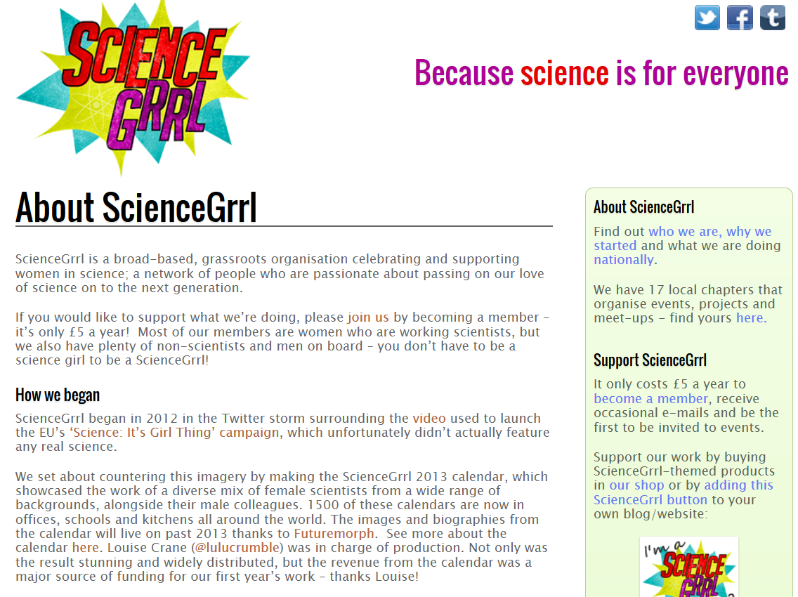
http://sciencegrrl.co.uk/about/

Slide 29
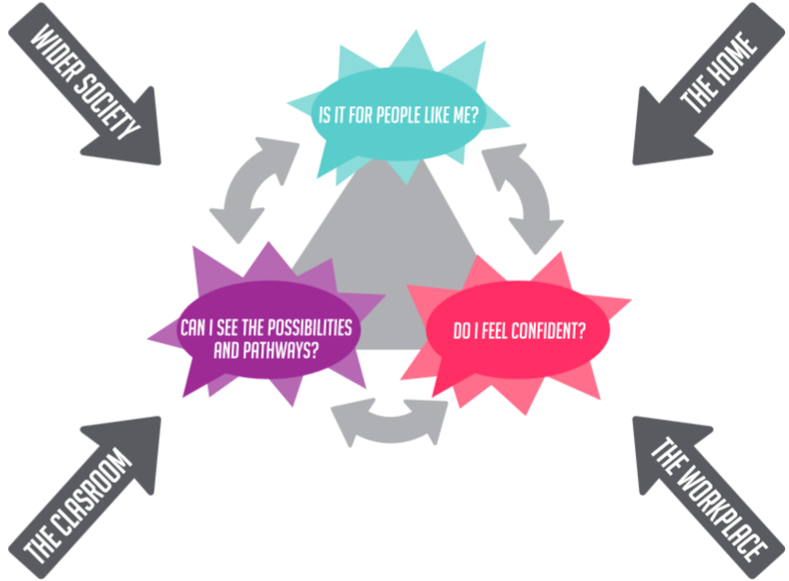
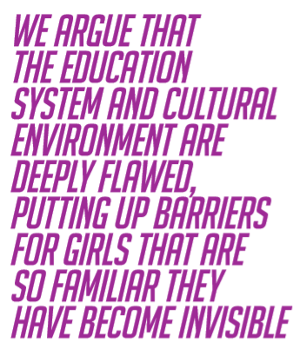
Science Grrl: The Effects of Gendered STEM Stereotypes
(Zecharia et al, 2013)

Slide 30
Further activities:
“The fact that science is seen as objective knowledge makes it an especially powerful agent of the reproduction and legitimation of naturalising and binary ideas about gender”. Discuss

Slide 31
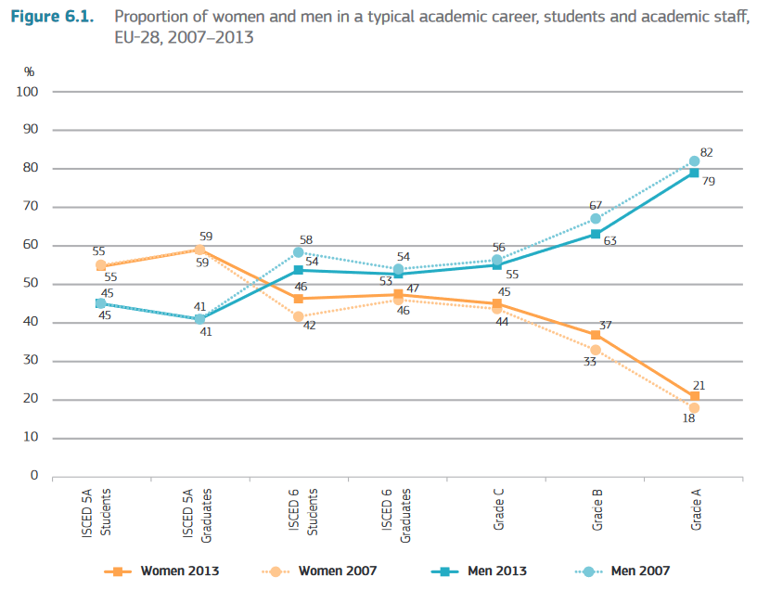
Gender Discrimination in Science in Europe
(She Figures,
2015)

Slide 32
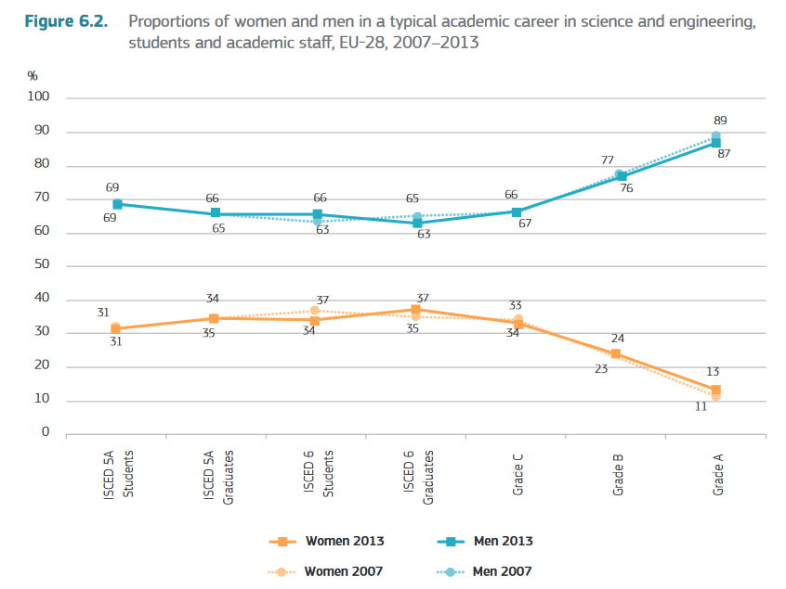
Gender Discrimination in Science in Europe
(She Figures,
2015)

Slide 33
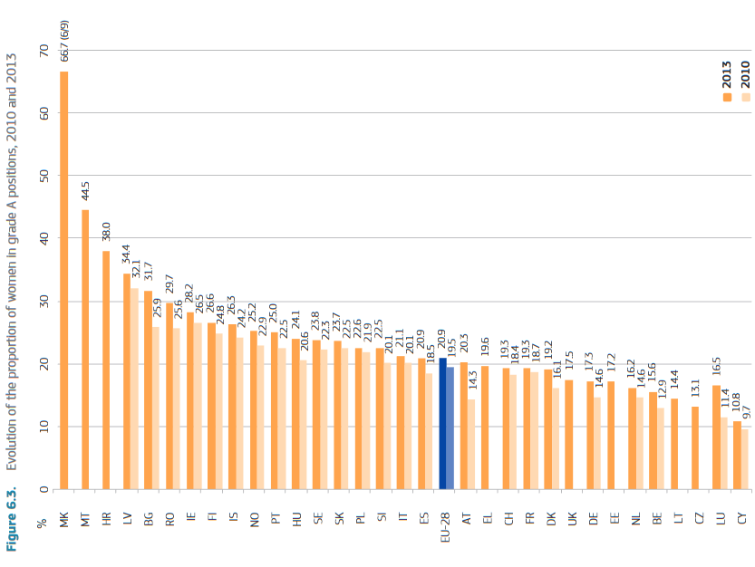
Gender Discrimination in Science in Europe
(She Figures, 2015)

Slide 34
References
Abbott, P. et al (2005), An Introduction to Sociology: Feminist Perspectives (3rd edition), London: Routledge.
Barres, B. (2006) ‘Does Gender Matter?’, Nature, 442 (13 July), 133 – 136.
Code, L. (1995) Rhetorical Spaces: Essays on Gendered Locations, New York: Routledge.
Connell, R. (2002) Gender, Cambridge: Polity Press.
Corrigan, O. (2002) ‘“First in man”: the politics & ethics of women in clinical drug trials’, Feminist Review,72, 40-52.
Dickersin, K. et al (1987) ‘Publication bias and clinical trials’, Controlled Clinical Trials, 8 (4): 343 - 353.
Eagly, A. (1995), ‘The Science and Politics of Comparing Women and Men’, American Psychologist, 50 (3), 145 - 158.
European Commission (2012), She Figures – Gender in Research and Innovation, Luxembourg: Publications Office of the European Union.
Fausto-Sterling, A. (1992) Myths of Gender, New York: Basic Books
Fine, C. (2008) ‘Will Working Mothers’ Brains Explode? The Popular New Genre of Neurosexism’, Neuroethics, 1 (1), 69 -72.
Fine, C. (2010) Delusions of gender: the real science behind sex differences, London: Icon.
Fine, C. (2012) ‘Neuroethics: Explaining, or Sustaining, the Status Quo? The Potentially Self-Fulfilling Effects of ‘Hardwired’ Accounts of Sex Differences’, 5 (3), 285 - 294.
Franklin, S. (1995) ‘Science as Culture, Cultures of Science’, Annual Review of Anthropology, 24, 163 - 184.
Hanmer, J. (1997) ‘Women and Reproduction’ in V. Robinson and D. Richardson (eds.), Introducing Women’s Studies, London: Macmillan.
Haraway, D. (1989) Primate Visions: Gender, Race and Nature in the World of Modern Science, New York: Routledge.
Harding, S. (1991) Whose Science? Whose Knowledge?: Thinking from Women’s Lives, Milton Keynes: Open University.
Herz, S, (1997) ‘Don't Test, Do Sell: Legal Implications of Inclusion and Exclusion of Women in Clinical Drug
Trials’, Epilepsia, 38, Issue Supplement s4, S42 – S49.
Jacobus, M. et al (eds.) (1990) Body Politics: Women and the Discourses of Science, New York: Routledge.
Jordan-Young, R. (2010) Brain Storm: The Flaws in the Science of Sex Differences, Cambridge: Harvard Univ. Press.

Slide 35
References (continued)
Kim, E. et al (2008) ‘Enrollment of Women in National Heart, Lung, and Blood Institute-Funded Cardiovascular Randomized Controlled Trials Fails to Meet Current Federal Mandates for Inclusion’, Journal of the American College of Cardiology, 52 (8), 672 – 673.
Kim, A. et al (2010) ‘Sex bias in trials and treatment must end’, Nature, 465 (10 June), 688 – 689.
Kitzinger, J. et al (2008) Gender, Stereotypes and Expertise in the Press: How Newspapers Represent Female and Male Scientists. Report for the UKRC. Available at: http://www.cardiff.ac.uk/jomec/research/researchgroups/
riskscienceandhealth/fundedprojects/womenscientists.html
Laqueur, T. (1990) Making Sex: Body and Gender from the Greeks to Freud, Cambridge: Harvard University Press.
Martin, E. (1991) ‘The Egg and the Sperm: How Science Constructed a Romance Based on Stereotypical Male-Female Roles’, Signs, 16 (3), 485-501.
Martin, E. (1992) The Woman in the Body: a Cultural Analysis of Reproduction, London: Beacon Press.
Mirza, Heidi (1998), “Race, Gender and IQ: the social consequence of a pseudo‐scientific discourse”, Race, Ethnicity and Education, 1 (1), 109 – 126.
Moss-Racusin, C. et al (2012),‘Science faculty’s subtle gender biases favour male students’, Proceedings of the National Academy of Sciences of the United States of America, 109, (41), 16474 - 16479.
Richardson, S. (2012) ‘Sexing the X: How the X Became the «Female Chromosome»’, Signs, 37 (4), 909 - 933.
Rodino, M. (1997) ‘Breaking out of Binaries: Reconceptualizing Gender and its Relationship to Language In Computer-Mediated Communication’, Journal of Computer-Mediated Communication, 3, (3).
Rosser, S. (1989) ‘Re-visioning Clinical Research: Gender & Ethics of Experimental Design’, Hypatia, 4(2), 125-139.
Schiebinger, L. (1994) Nature's body: sexual politics and the making of modern science, London: Pandora.
Schiebinger, L. (1999) Has Feminism Changed Science?, Cambridge: Harvard University Press.
Stepan, N. (1986) ‘Race and Gender: The Role of Analogy in Science’, Isis, 77 (2), 261 – 277.
Zecharia, A. et al (2013) Through Both Eyes: The Case for a Gender Lens in STEM, London: Science Grrl.
Zucker, I. and Beery, A. (2010) ‘Males still dominate animal studies’, Nature, 465 (10 June), 690.
Zuk, M. (1993) ‘Feminism and the Study of Animal Behavior’, BioScience, 43 (11), 774 - 778.

Slide 36
Maria do Mar Pereira: MA Modules
Ways of Knowing: Gender, Bodies, Power: https://warwick.ac.uk/fac/cross_fac/iatl/study/pgmodules/waysofknowing
Feminist Theory and Epistemology: Debates and Dilemmas: https://warwick.ac.uk/services/aro/dar/quality/modules/postgraduate/so/so9b0/
Maria’s homepage: https://warwick.ac.uk/fac/soc/sociology/staff/mariadomarpereira/

