Slide 1
The following podcast (Title: Seven things to know about sex, gender, brains and behavior) has been developed as part of the PLOTINA project
Project H2020 (2015-2020) GA n° 666008 Coordinated by
Alma Mater Studiorum – Università di Bologna
Prof. Tullia Gallina Toschi
Notes:
XXX = Name of the presenters
XXXX = Institution name of the WP Leaders
1

Slide 2

SEVEn things to know about sex, gender, brains and behaviour
Cordelia Fine
The University of Melbourne
www.cordeliafine.com

Slide 3
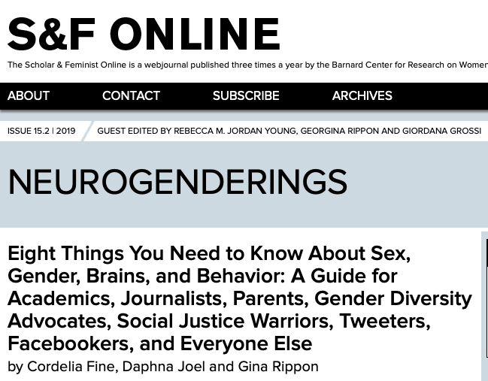

Slide 4
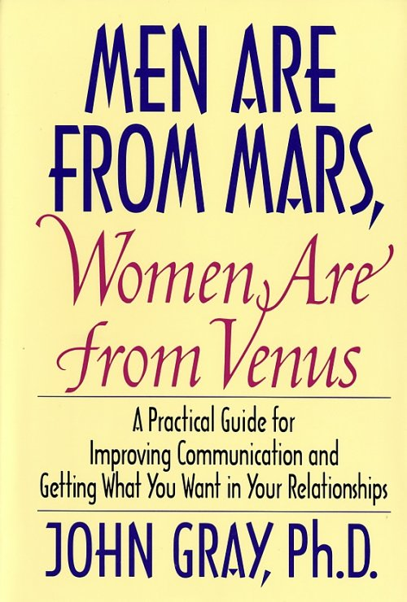
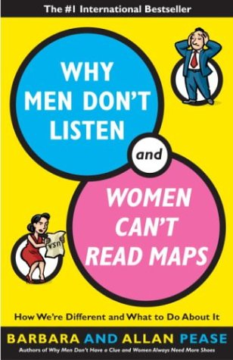
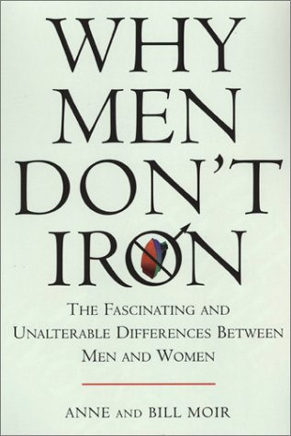
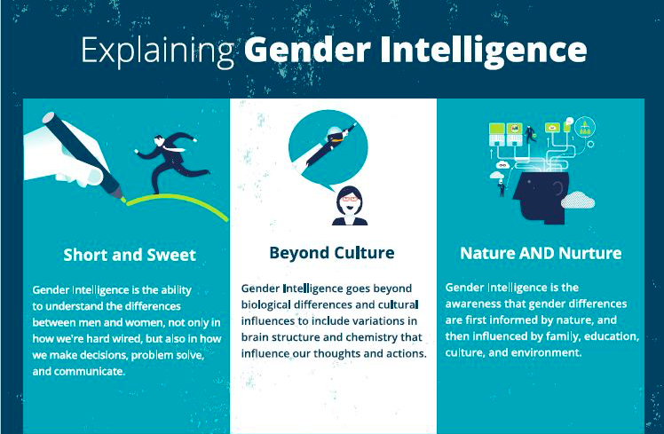
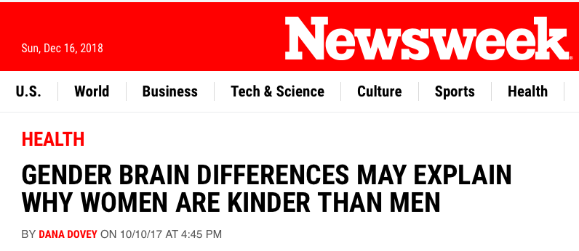
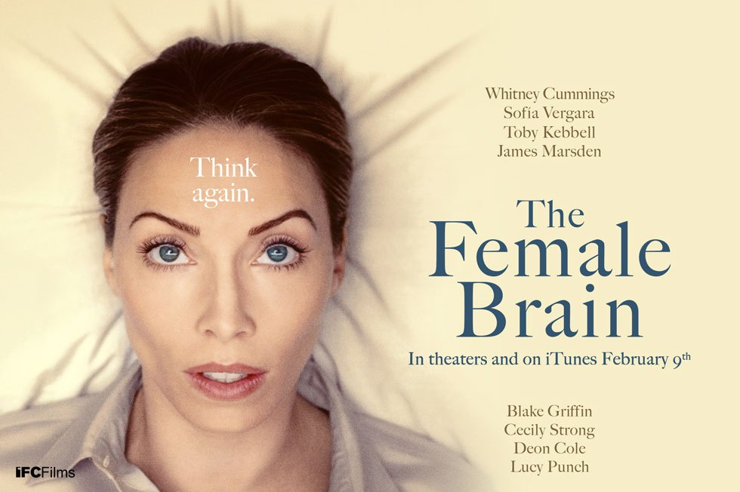
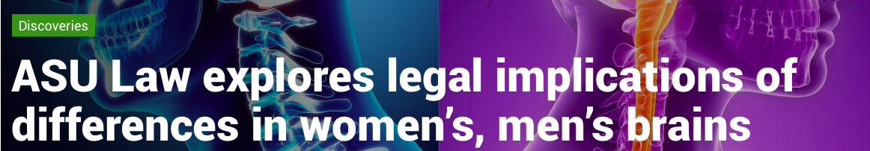
www.genderintelligence.com

Slide 5
1. Does a difference really exist?

Slide 6
Nature (1995)

Slide 7
Sommer et al. (2008). Sex differences in handedness, asymmetry of the Planum Temporale and functional language lateralization. Brain Research, 1206: 76-88. Elsevier

Slide 9
1. Does a difference really exist?
How big was the sample?
How many comparisons were made?
How many showed differences and how many found similarities?
Has the result been replicated in another sample?
How consistent is the finding with other studies?

Slide 10
2. How big is the difference?

Slide 11
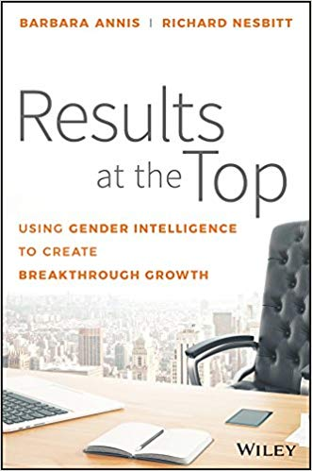
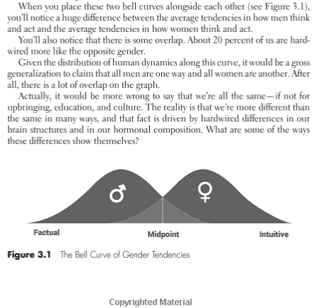

Slide 12
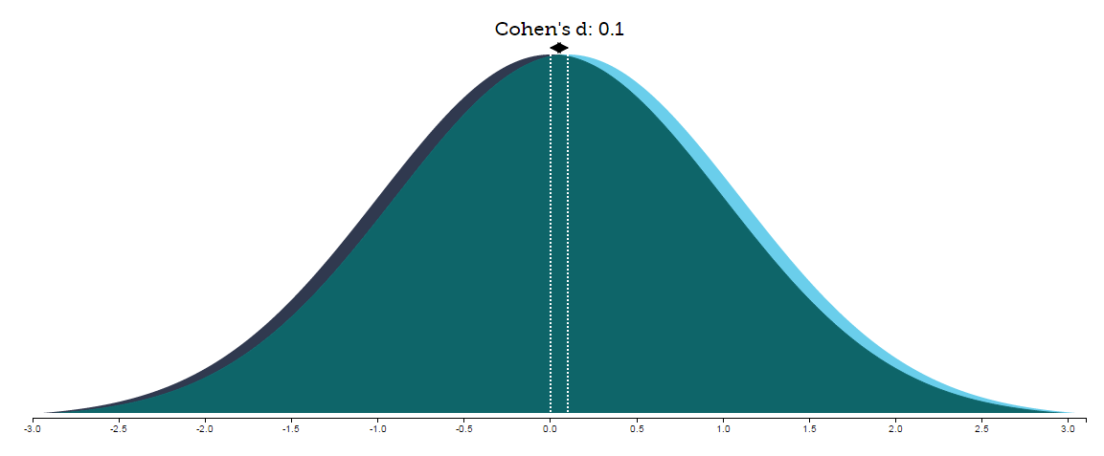
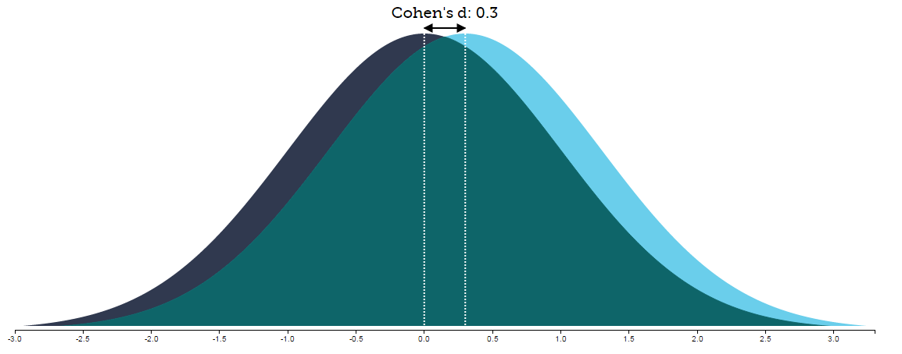
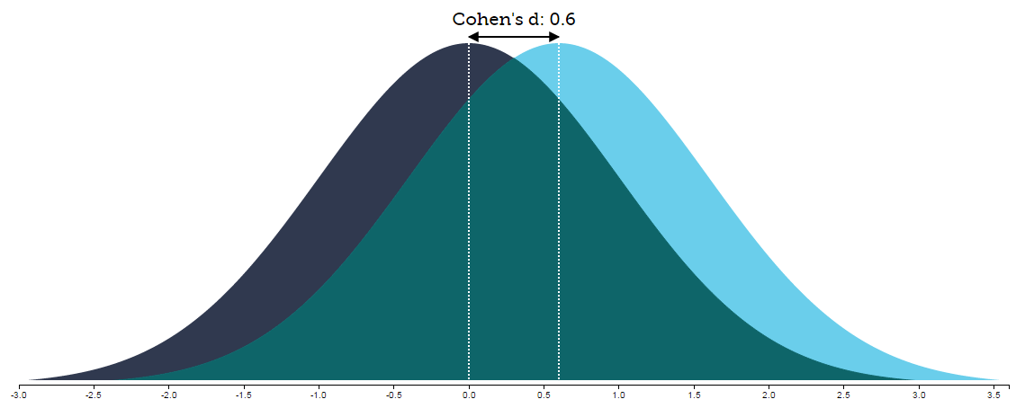
A 2005 review of 46 meta-analyses of ‘basic building blocks’ of behaviour (Hyde 2005):
30% were very small
(d = 0 to 0.1)
48% were small
(d = 0.11 to 0.35)
15% were medium
(d = 0.36 to 0.65)
Tool created by Kristoffer Magnusson, available at http://rpsychologist.com/d3/cohend/ licensed under a Creative Commons Attribution 4.0 International license.

Slide 13
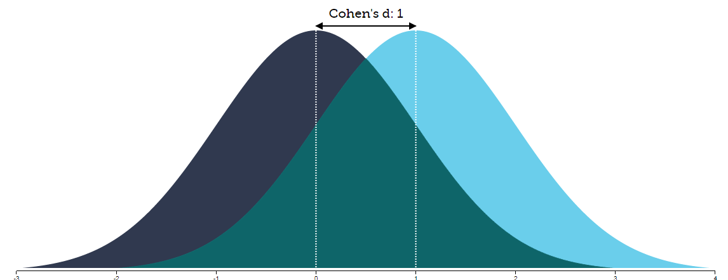
Tool created by Kristoffer Magnusson, available at http://rpsychologist.com/d3/cohend/ licensed under a Creative Commons Attribution 4.0 International license.

Slide 14
2. How big is the difference?
Is there an effect size for the difference?
What are the practical implications of this in the real world?
NB: with large samples, even tiny average differences can be statistically significant

Slide 15
3. What kind of difference?

Slide 16
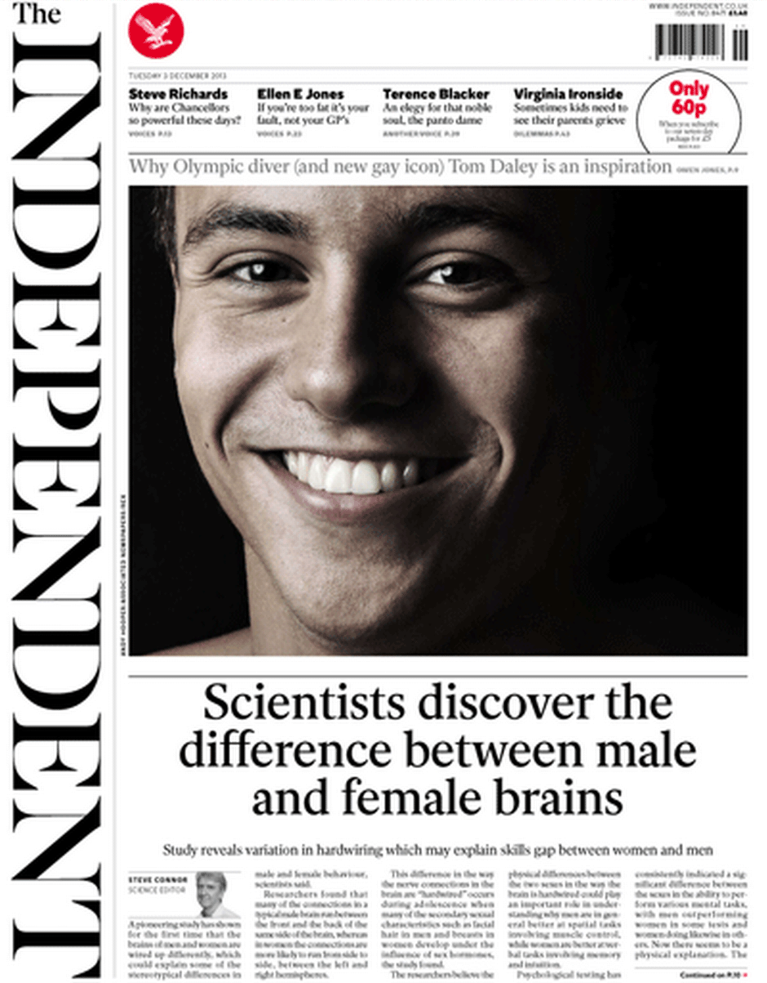

Slide 17
Survey of sex differences in brain structure in four large datasets found different ‘top ten’ differences, depending on data-set
Even in non-human animals, factors like stress and housing conditions can affect the existence or nature of sex differences in the brain.
Environment matters for sex-related behaviour too, even in animals.

Slide 18
3. What kind of difference?
Was the research done in varied environmental conditions?
Was the research done with varied (human) populations?

Slide 19
4. Where does it come from?

Slide 20
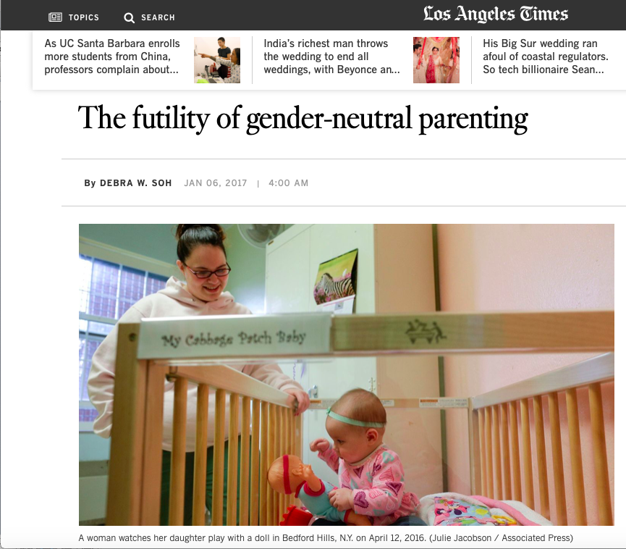
“a large and long-standing body of research literature shows that toy preferences, for example, are innate, not socially constructed or shaped by parental feedback.
…
“Girls with CAH tend to be gender nonconforming, and will prefer toys that are typical to boys, even when their parents offer more praise for playing with female-typical ones. This speaks to the vital role of hormones in developing gender preferences and sex differences in behavior, more broadly.”

Slide 23
From Joel & McCarthy (2016), Neuropsychopharmacology

Slide 24
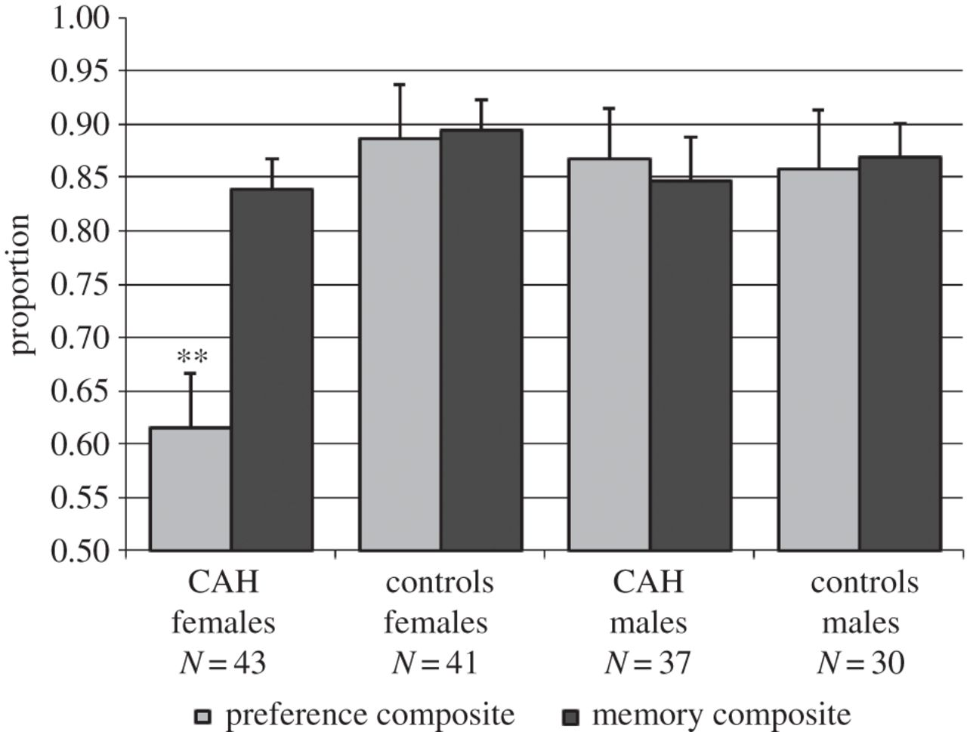

Composite scores for preferences and memory for gender-appropriate objects assessed using labelling and modelling paradigms.
Melissa Hines et al. Phil. Trans. R. Soc. B 2016;371:20150125
© 2016 The Author(s)‏
Notes:
Composite scores for preferences and memory for gender-appropriate objects assessed using labelling and modelling paradigms. The preference composite includes verbal preferences (labelling and modelling) as well as observed play (labelling). The memory composite includes memory scores from the labelling and modelling paradigms. All scores are mean proportions. **p < 0.01, girls with CAH differ compared to control girls, control boys and boys with CAH. There were no other group differences for preference scores, and there were no group differences for memory scores.

Slide 25
4. Where does it come from?
Could there have been indirect effects of sex, including the effects of sex-differentiated or gendered experiences on brain, hormones and behaviour?

Slide 26
5. How does it all add up?

Slide 27
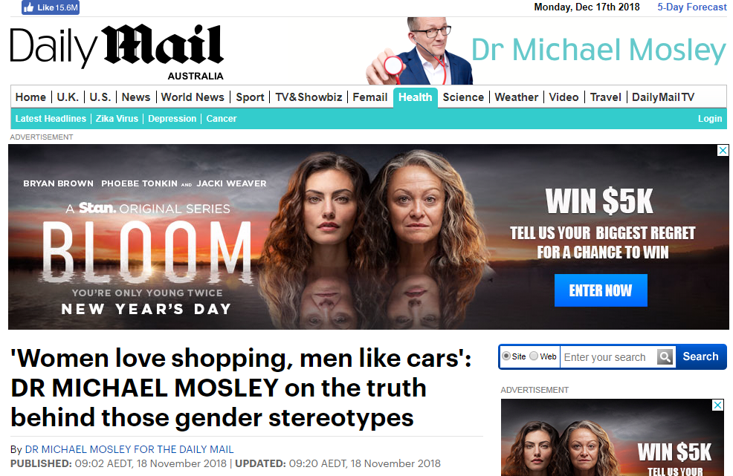

Slide 28
High
High

Slide 29
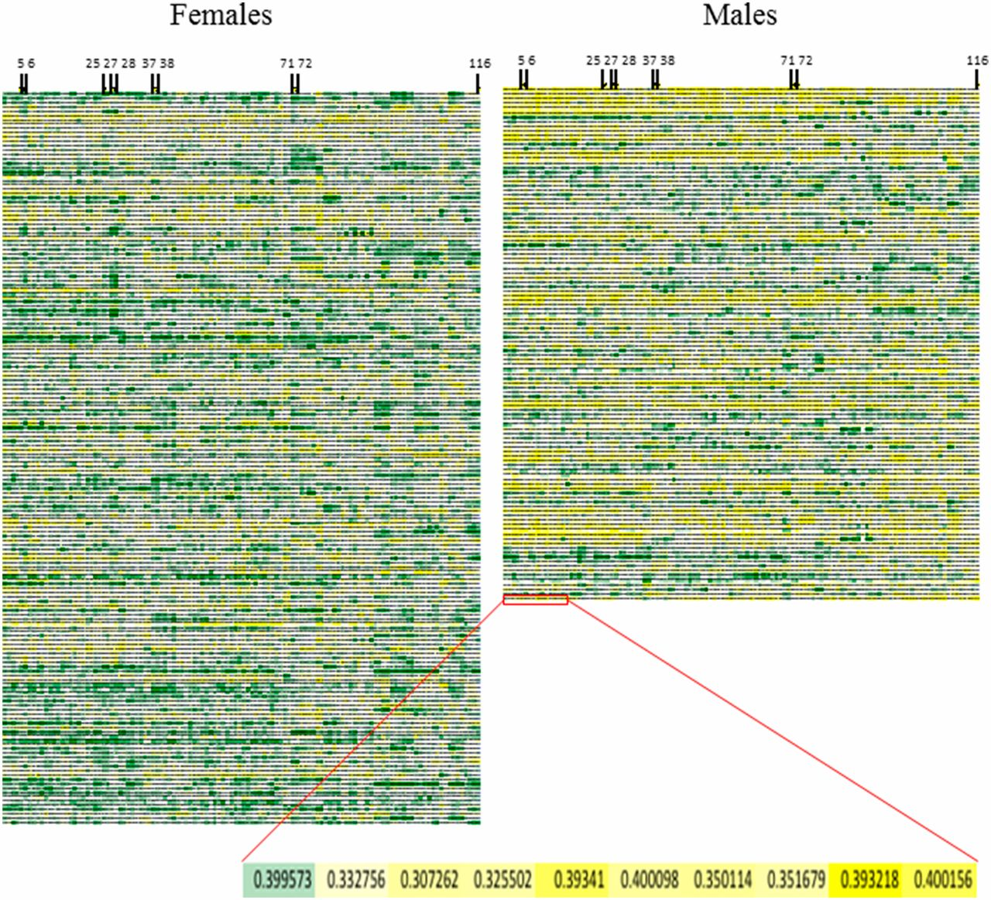
The human brain mosaic.
Daphna Joel et al. PNAS 2015;112:15468-15473
Notes:
The human brain mosaic. The gray matter volume of all 116 regions of gray matter in females (Left) and in males (Right) from the first sample is represented using a continuous high-low (green-white-yellow) scale. Each horizontal line represents the brain of a single subject and each column represents a single brain region. The continuous high-low scale represents the relative volume of a brain region in a given brain relative to the volume of this brain region in all other brains (i.e., within a column). The regions that showed the largest sex/gender differences and were included in the internal consistency analysis are marked with a black bar. The number above each bar corresponds to the region’s number in the AAL atlas and in Table S1. (Inset) Magnification of a small part of a horizontal line (i.e., a single brain). The number in each colored cell is the volume of this region for this brain.
Behavioural mosaic. Implications for gender inequalities, and thinking about psychopathology. From ‘extreme male brain’ or ‘extreme female brain’ to different frequencies of mosaics.

Slide 30
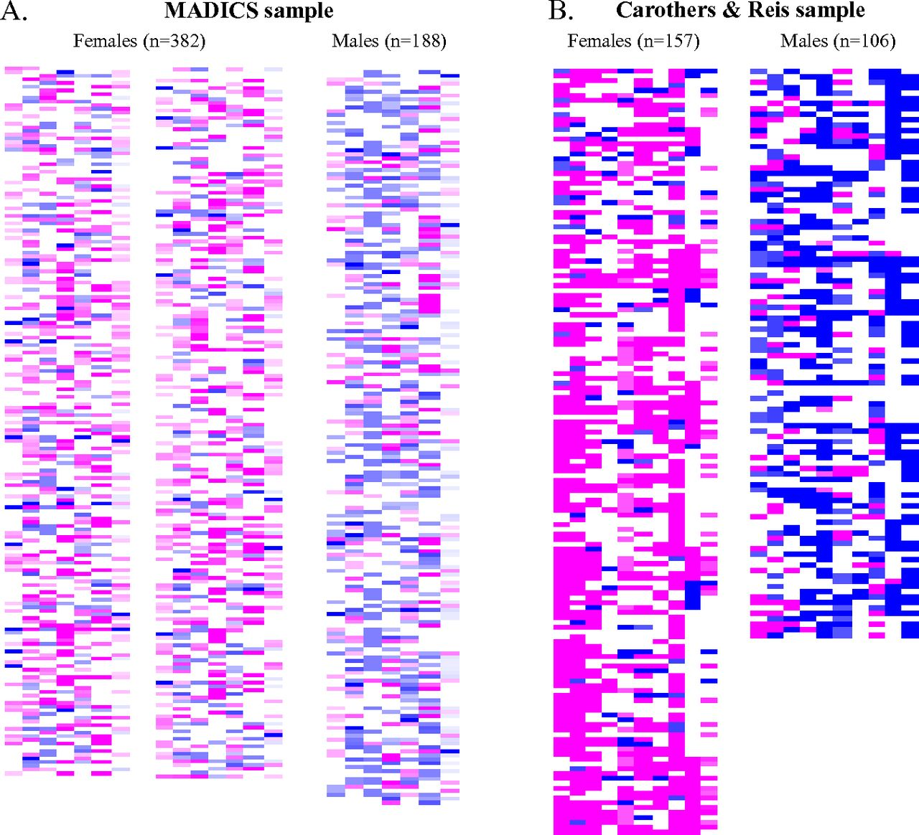

The human gender mosaic.
Items like: expectations of sexual discrimination, problem behaviour
Items like: boxing, use of cosmetics
Daphna Joel et al. PNAS 2015;112:50:15468-15473
©2015 by National Academy of Sciences
Notes:
The human gender mosaic. A color representation of the degree of femininity-masculinity [pink (“female-end”) – white (“intermediate”) – blue (“male-end”)] of the variables showing the largest sex/gender differences in the (A) MADICS sample and (B) Carother and Reis’ sample. The pink-white-blue scales were created as in Fig. 2D. Each line is a subject and each column is a single characteristic. The order of columns from left to right is the same as the order of variables in Table S5.

Slide 31
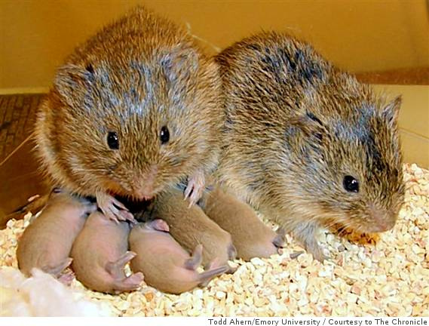
From: https://www.flickr.com/photos/30793552@N04/7523368472
Made available through Creative Commons

Slide 32

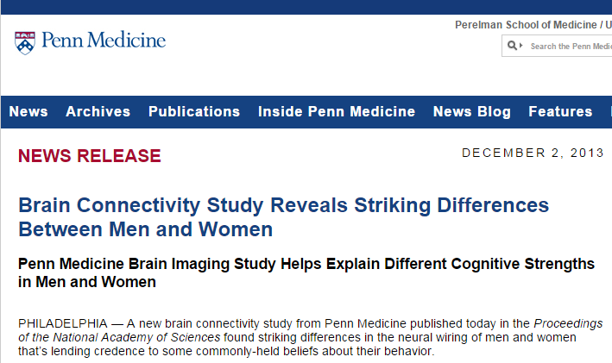
Sex differences in the structural connectome of the human brain
Ingalhalikar et al. (2014)
From: http://www.uphs.upenn.edu/news/news_releases/2013/12/verma/

Slide 34
5. How does it all add up?
Is the difference considered in isolation, or in the context of other relevant characteristics that might cancel out, compensate, or generally all come out in the wash?

Slide 35
6. What does a brain difference mean?

Slide 36

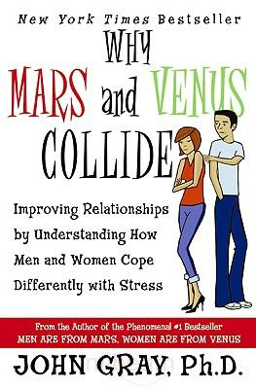
The “signal” of an emotional feeling, having made it to the right hemisphere, “may well get stopped, disappearing into neural oblivion because the signal found no access to a receptor in a language center in the left side of the brain.”
“This stronger connection between different parts of the brain increases a woman’s ability to multitask.”
“Men tend to do one thing at a time in their brains and in life … He may be focusing on how to get that promotion, so he forgets to bring home the milk. A woman can easily misinterpret his forgetful behavior as uncaring.”

Slide 37
“For instance, on average, men are more likely better at learning and performing a single task at hand, like cycling or navigating directions, whereas women have superior memory and social cognition skills, making them more equipped for multitasking and creating solutions that work for a group.”

Slide 38
A skew towards local connectivity is “compatible with strong systemizing, because systemizing involves a narrow attentional focus to local information, in order to understand each part of a system.”
Baron-Cohen et al. (2005), Science.
A locally connected brain is better suited to research disciplines that require “detailed scrutiny of narrowly characterized processes”, like physics and math, while the female brain may be better for “disciplines that require integration”.
Gur & Gur (2007) In Why aren’t there more women in science?

Slide 39
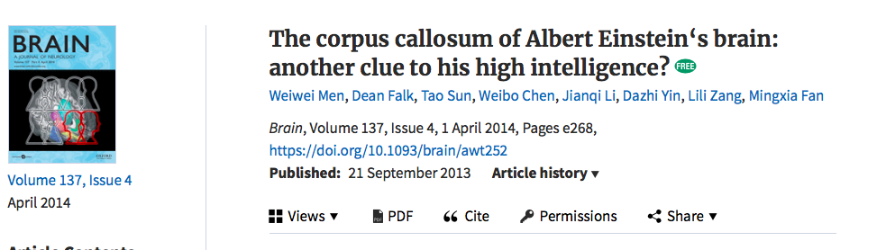
A skew towards local connectivity is “compatible with strong systemizing, because systemizing involves a narrow attentional focus to local information, in order to understand each part of a system.”
Baron-Cohen et al. (2005), Science.
A locally connected brain is better suited to research disciplines that require “detailed scrutiny of narrowly characterized processes”, like physics and math, while the female brain may be better for “disciplines that require integration”.
Gur & Gur (2007) In Why aren’t there more women in science?
“[O]ur findings suggest that Einstein’s extraordinary cognition was related not only to his unique cortical structure and cytoarchitectonics, but also involved enhanced communication routes between at least some parts of his two cerebral hemispheres.”

Slide 40
6. What does a brain difference mean?
If you turned the explanation upside down, would it make about the same amount of sense?
P.S. Don’t forget to ask all the other questions as well!

Slide 41
7. Evolutionary explanations

Slide 42
From: Lovatt P. This is why we dance. BBC Science Focus. 2016.

Slide 43

“[I]n mammals the fitness consequences of rank in a dominance hierarchy are better established for females than for males.”

Slide 45
7. Evolutionary explanations
Is there any evidence that the gendered behaviour enhanced reproductive success in environments thought to be similar to those in which selection occurred?
Have the researchers provided any evidence the behaviour is genetically heritable?
Have they considered other transfer mechanisms, including cultural ones?

Slide 46
One big myth …
That asking these questions is a symptomatic of:
Being a ‘blank-slater’
Being driven by political ideology
Mistakenly thinking that political equality depends on psychological sameness

Slide 47
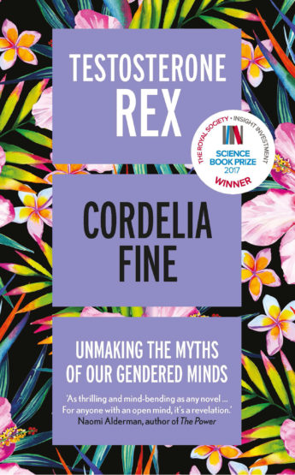
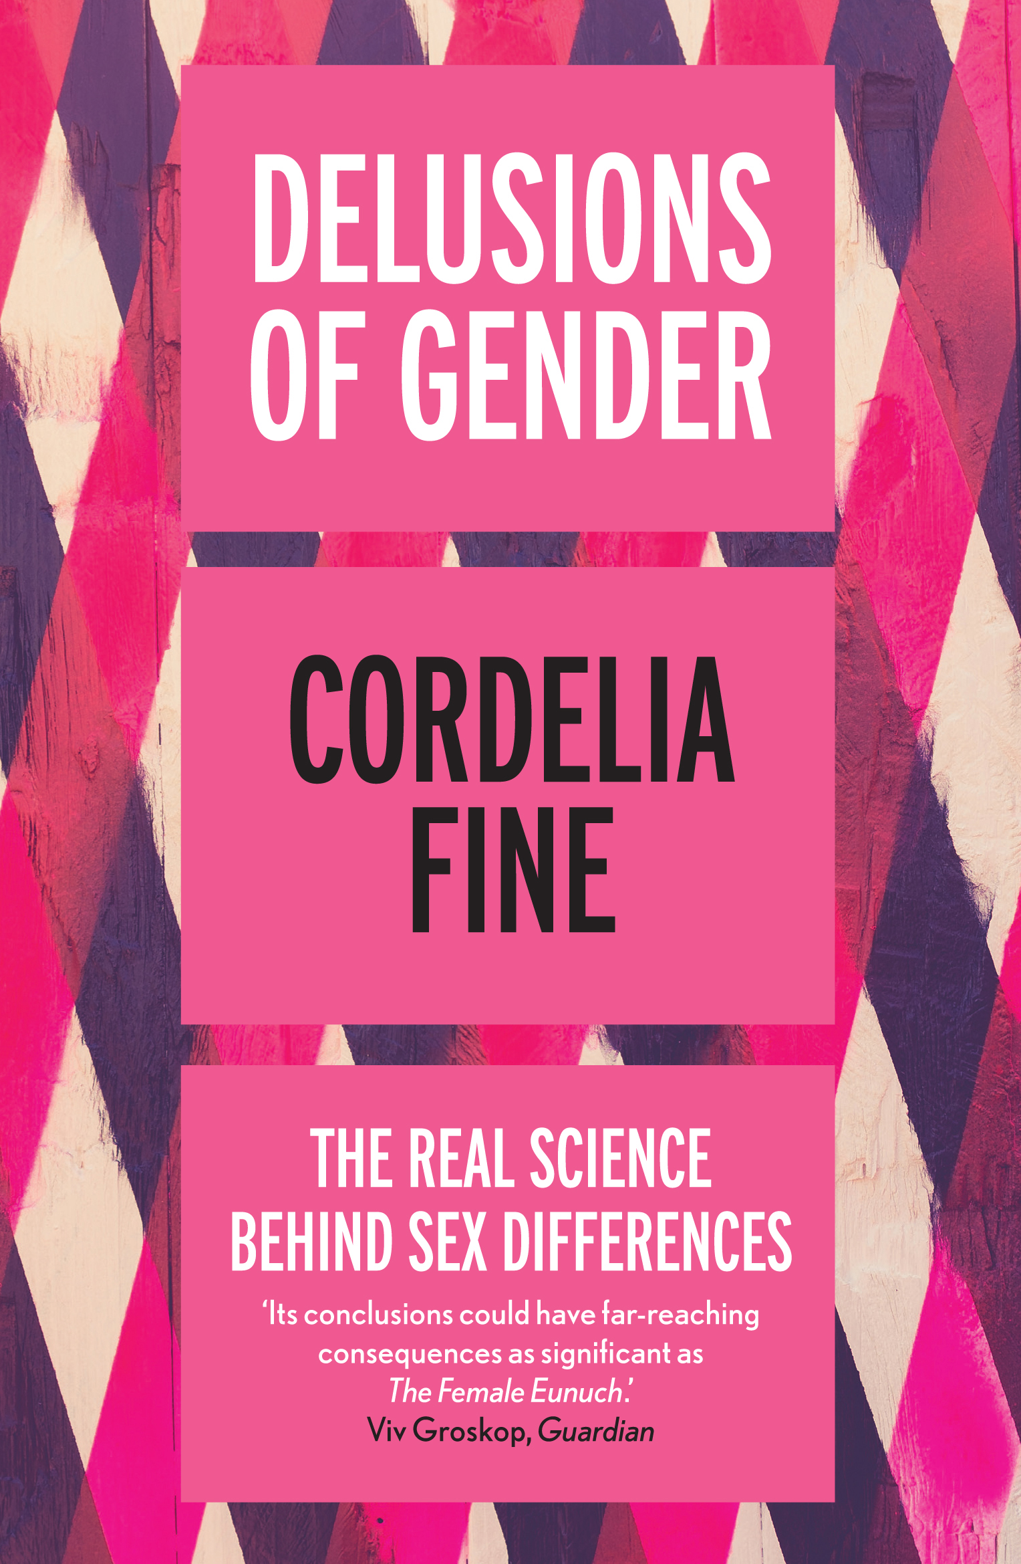
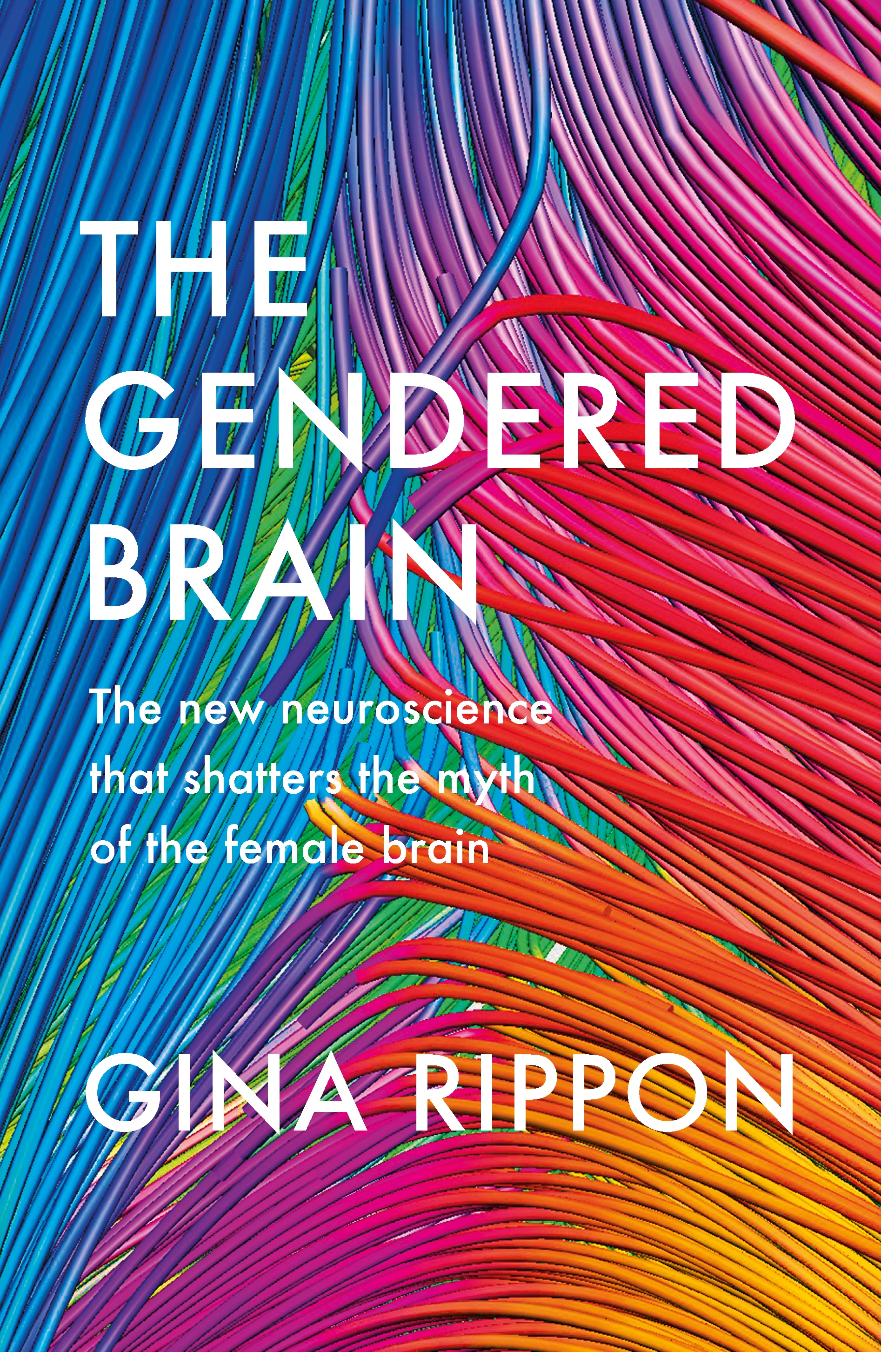
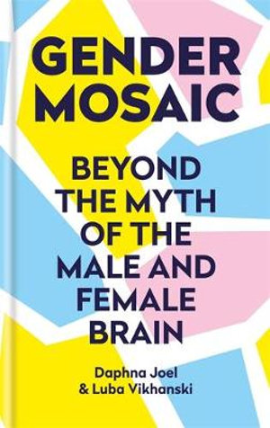
Thank you:
Interested to read more …?
www.cordeliafine.com

