Slide 1
The following podcast (Title: Gender and the history of science) has been developed as part of the PLOTINA project
Project H2020 (2015-2020) GA n° 666008 Coordinated by
Alma Mater Studiorum – Università di Bologna
Prof. Tullia Gallina Toschi
Notes:
XXX = Name of the presenters
XXXX = Institution name of the WP Leaders
1

Slide 2
Gender and the history of science
Dr. Michael Bycroft
History Department, University of Warwick

Slide 3
Why is it not as illuminating and honest to refer to Newton’s laws as ‘Newton’s rape manual’ as it is to call them ‘Newton’s mechanics’?
- Sandra Harding, The Science Question in Feminism (1986)

Slide 4
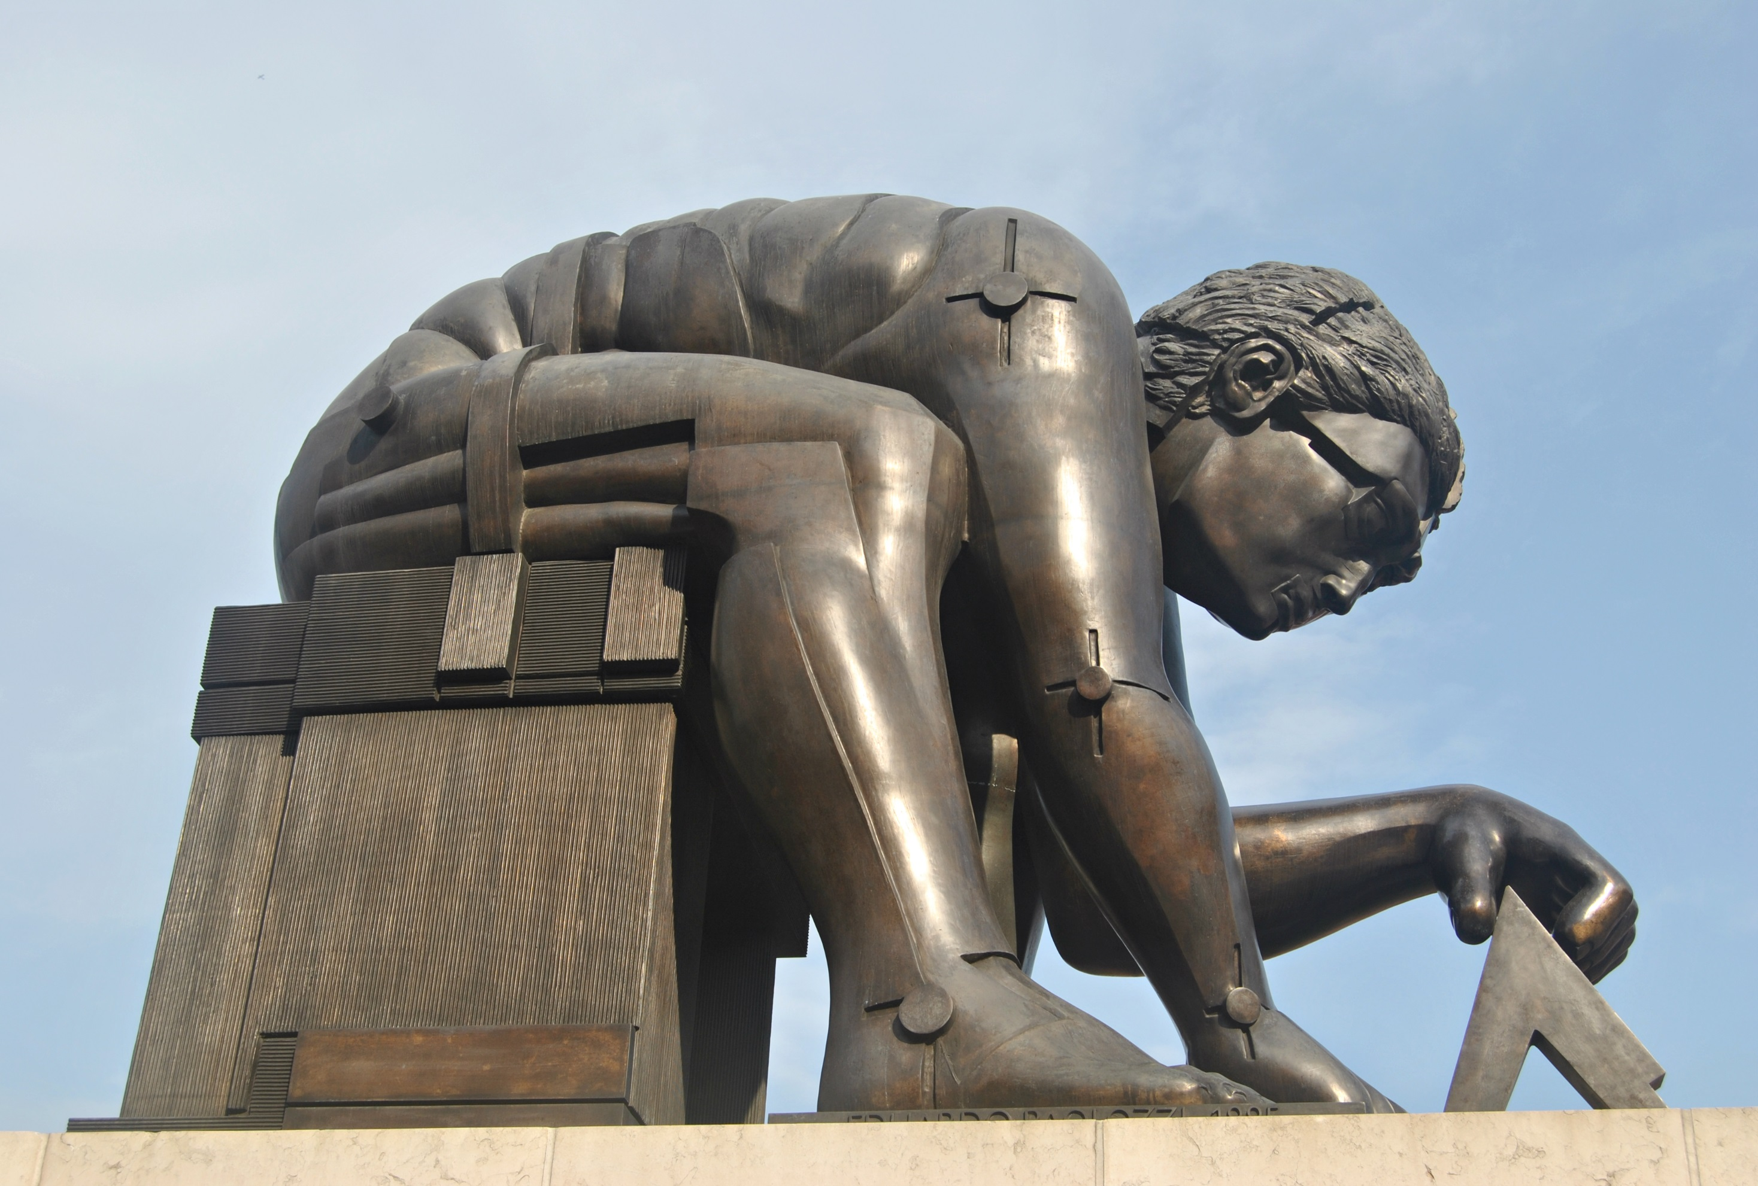

Slide 5
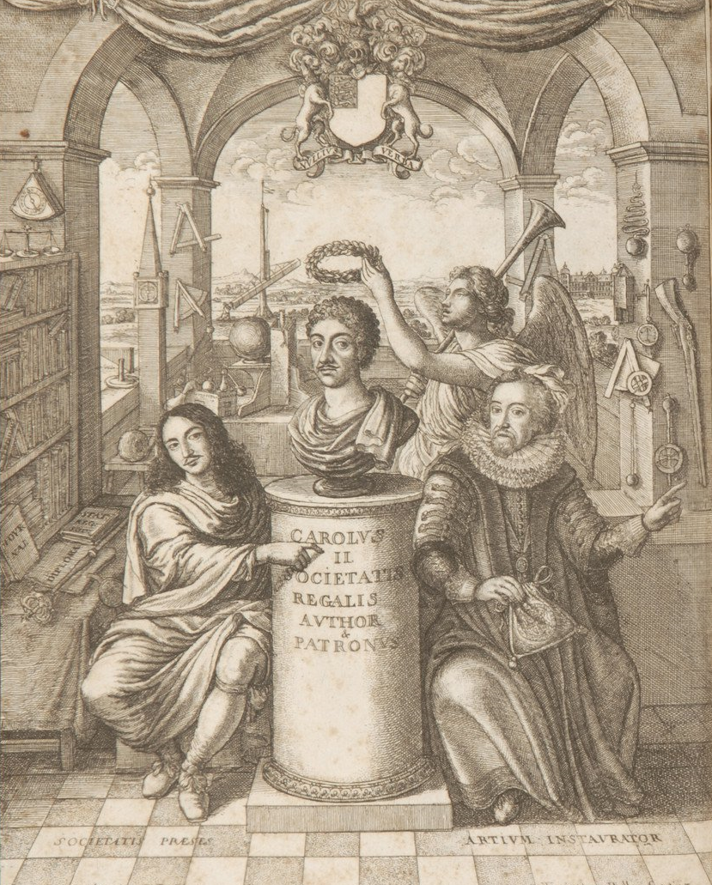

Slide 6
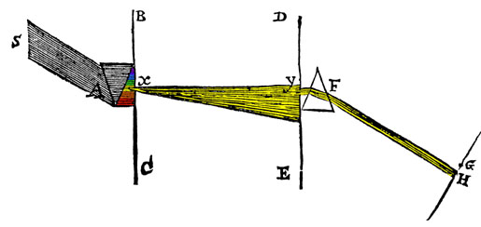

Slide 7
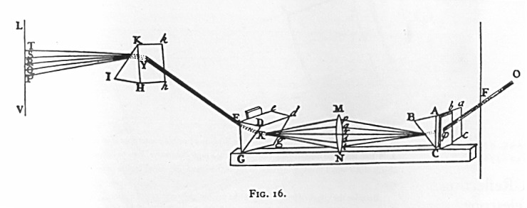
re-combination
separation

Slide 8
And no doubt, if the Worship of false Gods had not blinded the Heathen, their moral Philosophy would have gone farther than to the four Cardinal Virtues; and instead of teaching the Transmigration of Souls [ie. reincarnation], and to worship the Sun and Moon, and dead Heroes, they would have taught us to worship our true Author and Benefactor, as their Ancestors did under the Government of Noah and his Sons before they corrupted themselves
-- last sentence in Newton’s Opticks, 1704

Slide 9
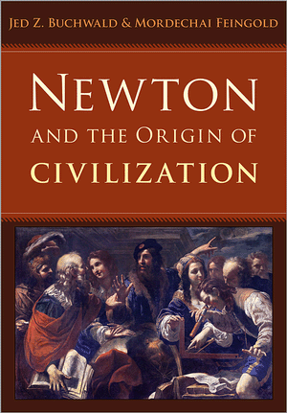

Slide 10
[Inequality between the rights of men and women] has no other origin except the abuse of power, and it is in vain that people have tried to excuse it with sophisms.
Women cannot rise to the same heights as extraordinary men…There could never be a female Euler or Voltaire, though there could be a female Pascal or Rousseau.
-- Nicolas de Caritat, marquis de Condorcet, Sketch of the Progress of the Human Mind, 1795

Slide 11
